Slide 1
Apple Maturity Detection using Deep Learning
This presentation discusses the use of deep learning techniques, specifically Convolutional Neural Networks (CNN) and YOLOv8, for automated apple maturity detection. The presentation covers the advantages and process of using deep learning for this task, as well as the potential applications in the agricultural industry.
Name – Saksham Rawat
Reg. No. - 209301285

Slide 2
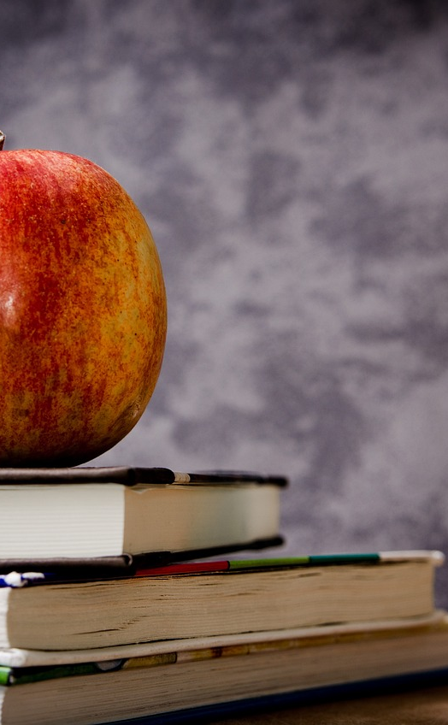
Introduction to Apple Maturity Detection
- Critical task in the agriculture industry for sorting and packaging apples according to their ripeness level.
- Traditionally performed manually by human inspectors, which is time-consuming and prone to errors.
Photo by Pixabay

Slide 3
Advantages of Deep Learning for Apple Maturity Detection
- Ability to learn and detect complex patterns in apple images.
- Highly effective at distinguishing between different ripeness levels of apples.

Slide 4
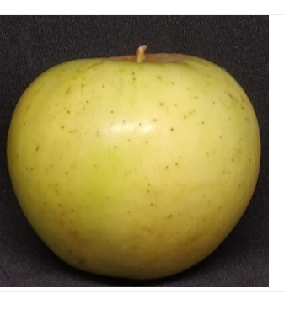
Dataset
The DataSets used are Malus Sylvestris and it’s collected from Kaggle. It contains 100 images of European crab apple.
Fruits 360 and it’s also collected from Kaggle.It’s a dataset of images containing fruits and vegetables. The total number of images containing are 90483
Test Images are taken from Getty Images and from the web
Photo by Pixabay

Slide 5
Convolution Neural Networks (CNN)
Various Parameters in CNN are:
Convolutional Kernels: These are the filters that are applied to the input image during the convolutional layers. Each kernel is a small matrix of weights that are learned during training.
Bias terms: Each convolutional kernel has an associated bias term that is added to the output of the convolution operation.
Pooling Parameters: In the pooling layers, the size of the pooling window and the stride length are parameters that are learned during training.
Fully Connected Layer Weights: In the fully connected layers, there are weight parameters associated with each connection between the neurons.
Fully Connected Layer Biases: Each neuron in the fully connected layers has an associated bias term that is added to its output.

Slide 6
YOLOv8 Object Detection Algorithm
- Also Known as You Only Look Once (YOLO).
It’s A State of the Art (SOTA) Object Detection Algorithm.
- To use yoloV8 we must have an annotated dataset in the yolo 1.1 format.
- Uses a single neural network to detect objects in real-time.
- Highly accurate and efficient at detecting apple maturity levels.

Slide 7
Process of Apple Maturity Detection using CNN and YOLOv8
- Collect a large dataset of images of apples at different stages of ripeness, with labels indicating their maturity level.
- Pre-process the dataset, including image resizing, normalization, and augmentation.
- Train the CNN and YOLOv8 models on the pre-processed dataset.
- Evaluate the accuracy of the models using validation and testing datasets.

Slide 8
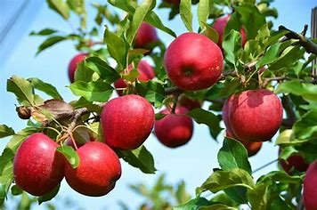
Deployment of Apple Maturity Detection Models
- Models can be deployed in real-world scenarios, such as fruit sorting machines or mobile apps for consumers.
- Automated apple maturity detection can save time and reduce errors, resulting in improved efficiency and profitability.
Photo by Pixabay

Slide 9
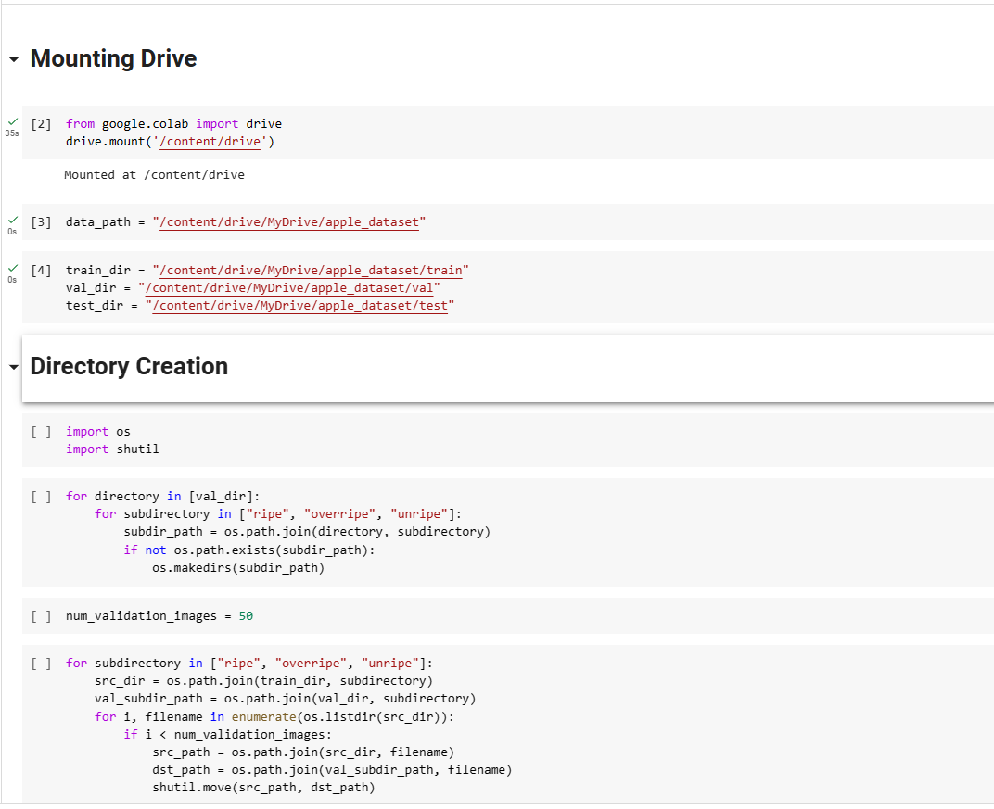
Implementation
Photo by Pixabay

Slide 10
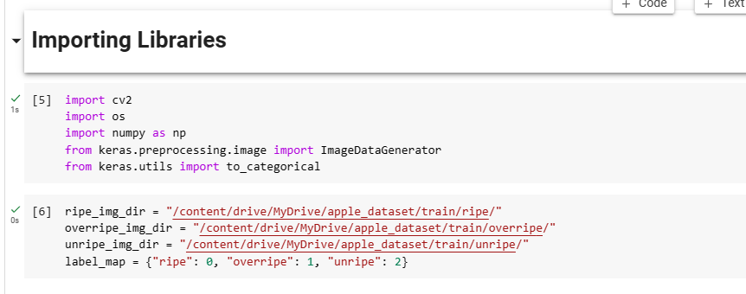
Implementation
Photo by Pixabay

Slide 11
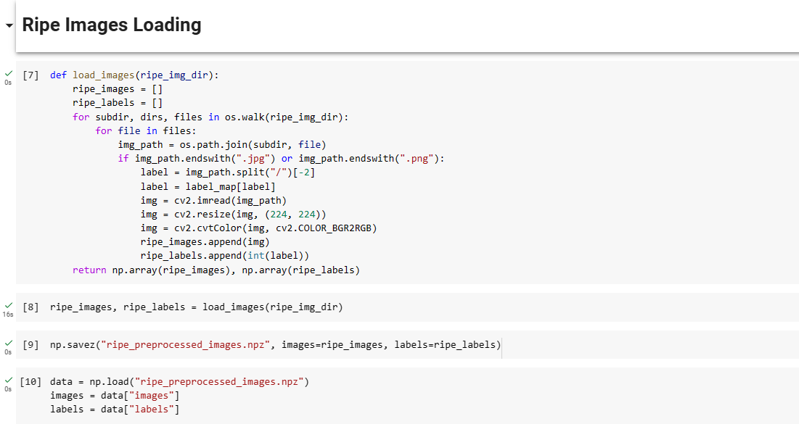
Implementation
Photo by Pixabay

Slide 12
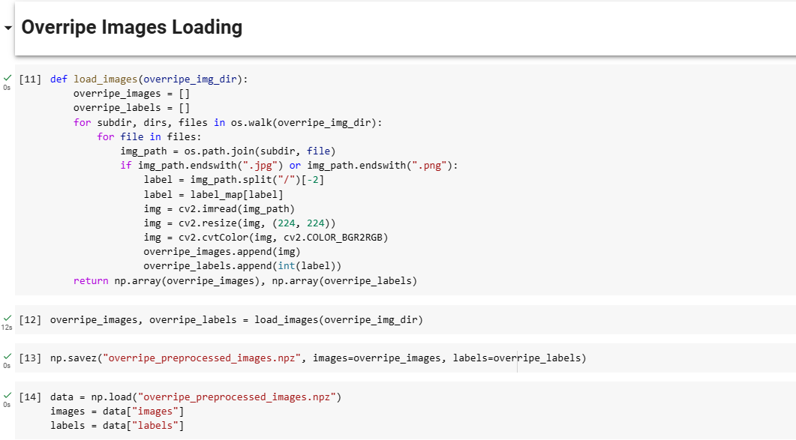
Implementation
Photo by Pixabay

Slide 13
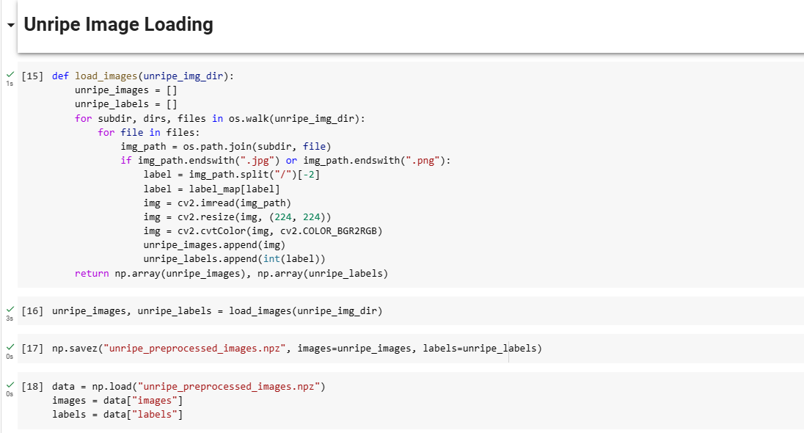
Implementation
Photo by Pixabay

Slide 14
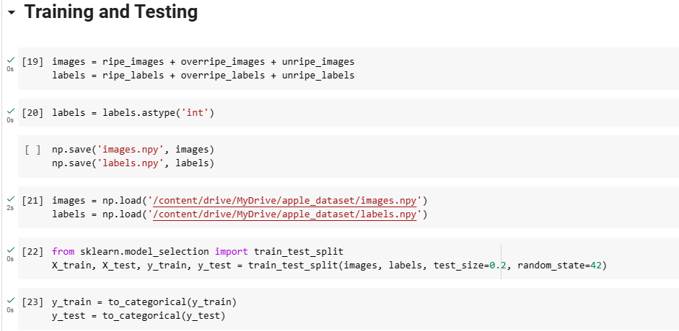
Implementation
Photo by Pixabay

Slide 15
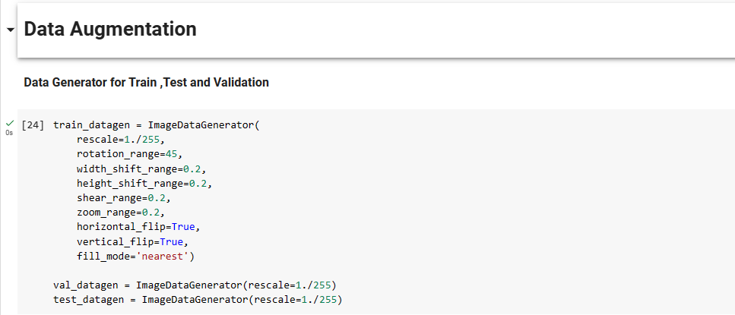
Implementation
Photo by Pixabay

Slide 16
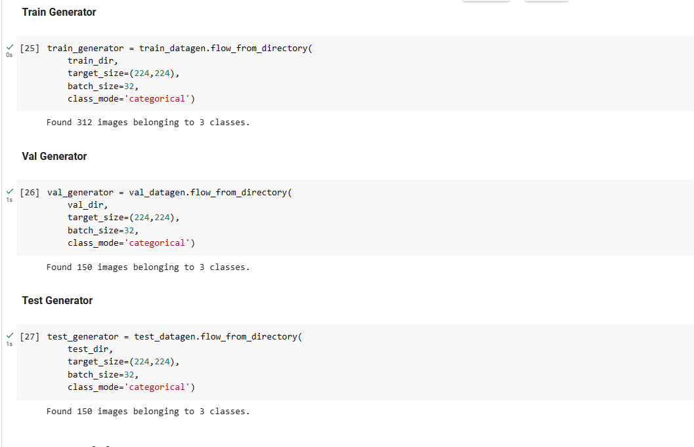
Implementation
Photo by Pixabay

Slide 17
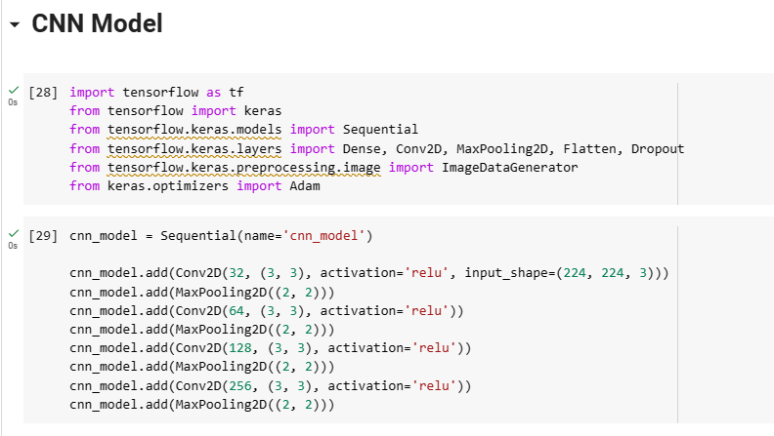
Implementation
Convolution Layers having 32 filters
Pool Size (2,2) which reduces spatial dimension by factor of 2
Photo by Pixabay

Slide 18
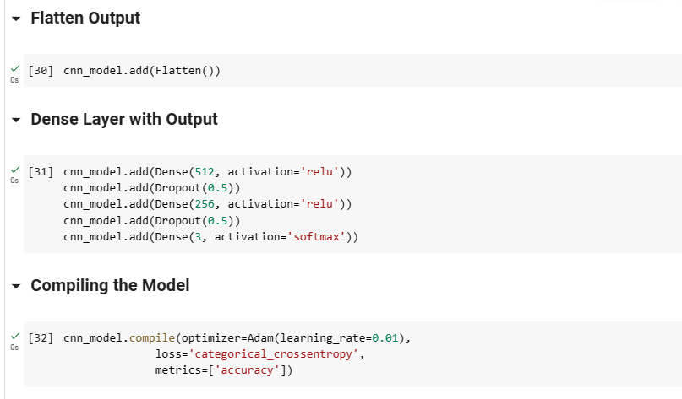
CNN Model
ReLU function returns 0 for all negative inputs and returns the input value for all non-negative inputs
Gives vector output of probabilities that sum up to 1
Photo by Pixabay

Slide 19
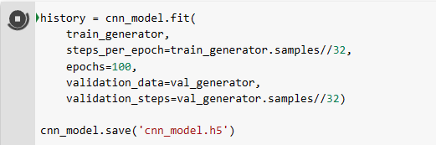
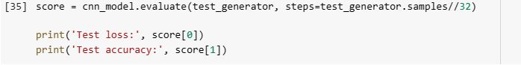
CNN Model
Photo by Pixabay

Slide 20
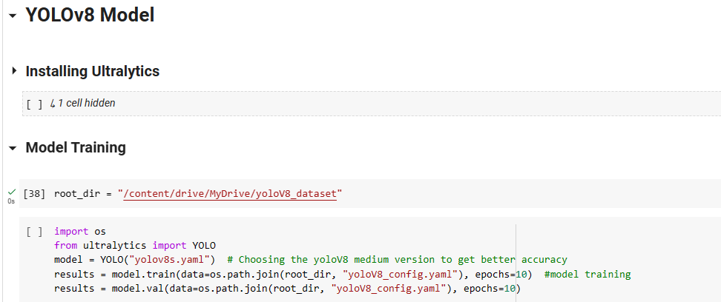
YOLOv8 Model
Photo by Pixabay

Slide 21
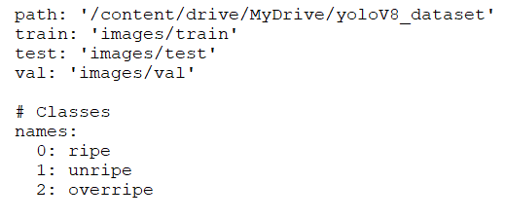
yoloV8Config.yaml file
Photo by Pixabay

Slide 22
YOLOv8 Model
Photo by Pixabay

Slide 23
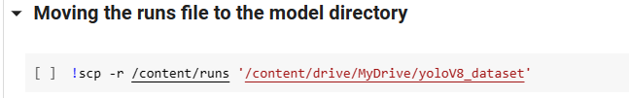
YOLOv8 Model
Photo by Pixabay

Slide 24
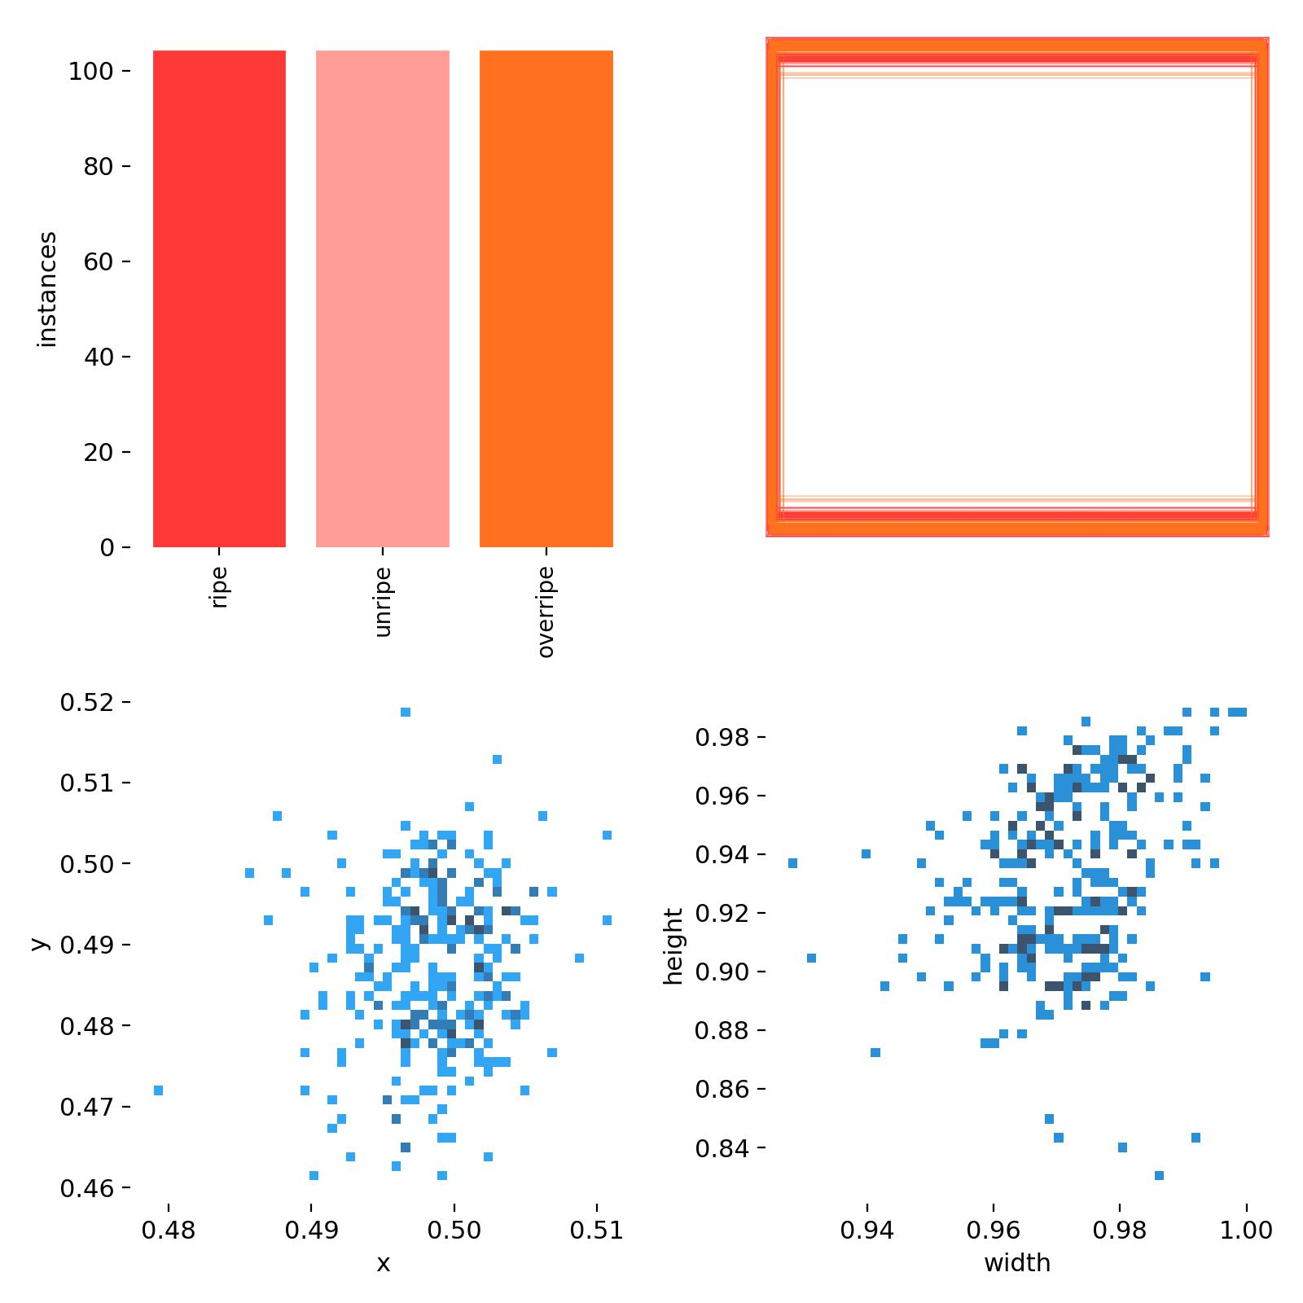
YOLOv8 Model Labels
Photo by Pixabay

Slide 25
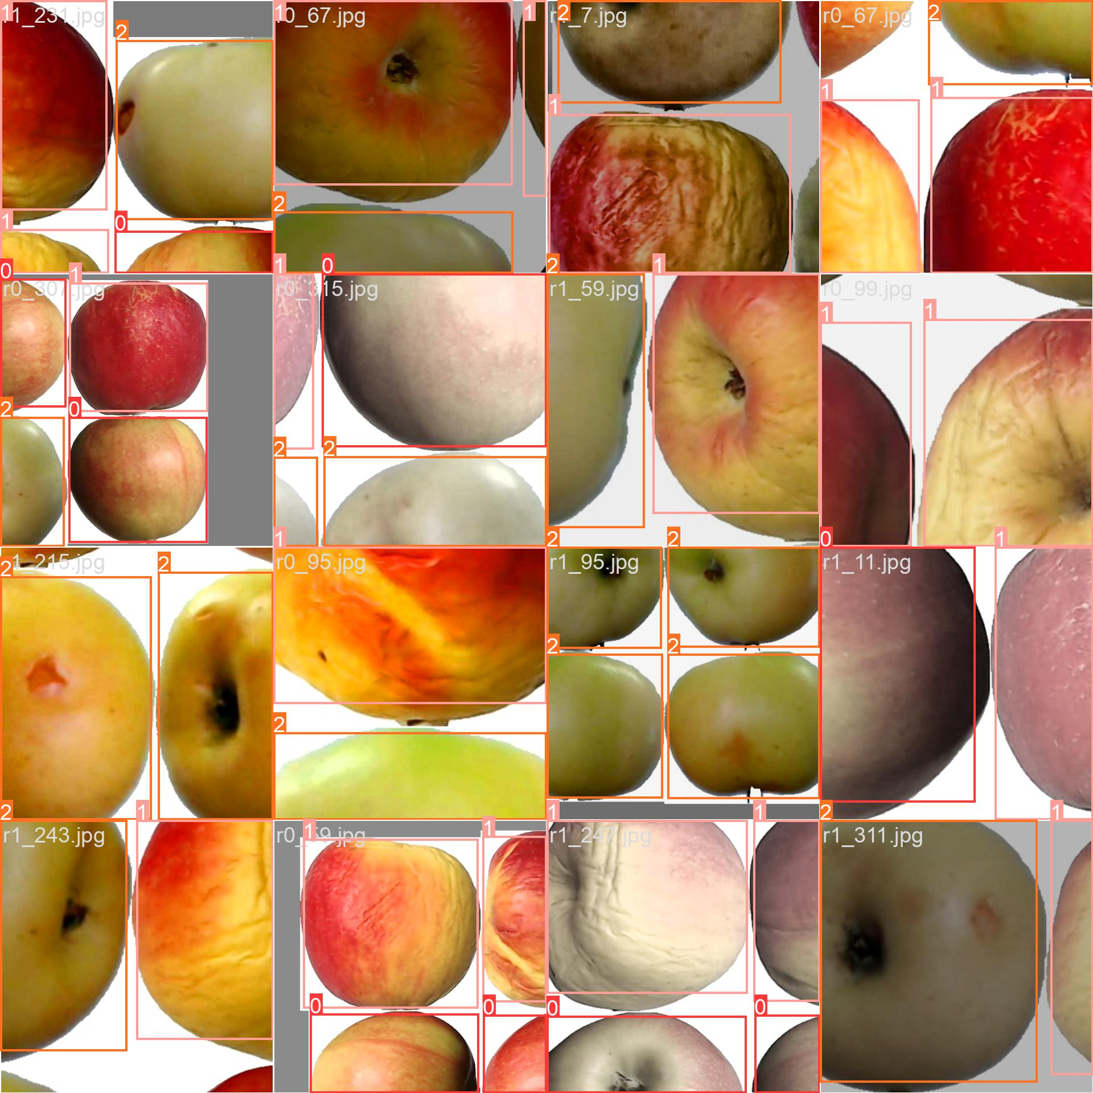
YOLOv8 Model Train Batch Photos
Photo by Pixabay

Slide 26
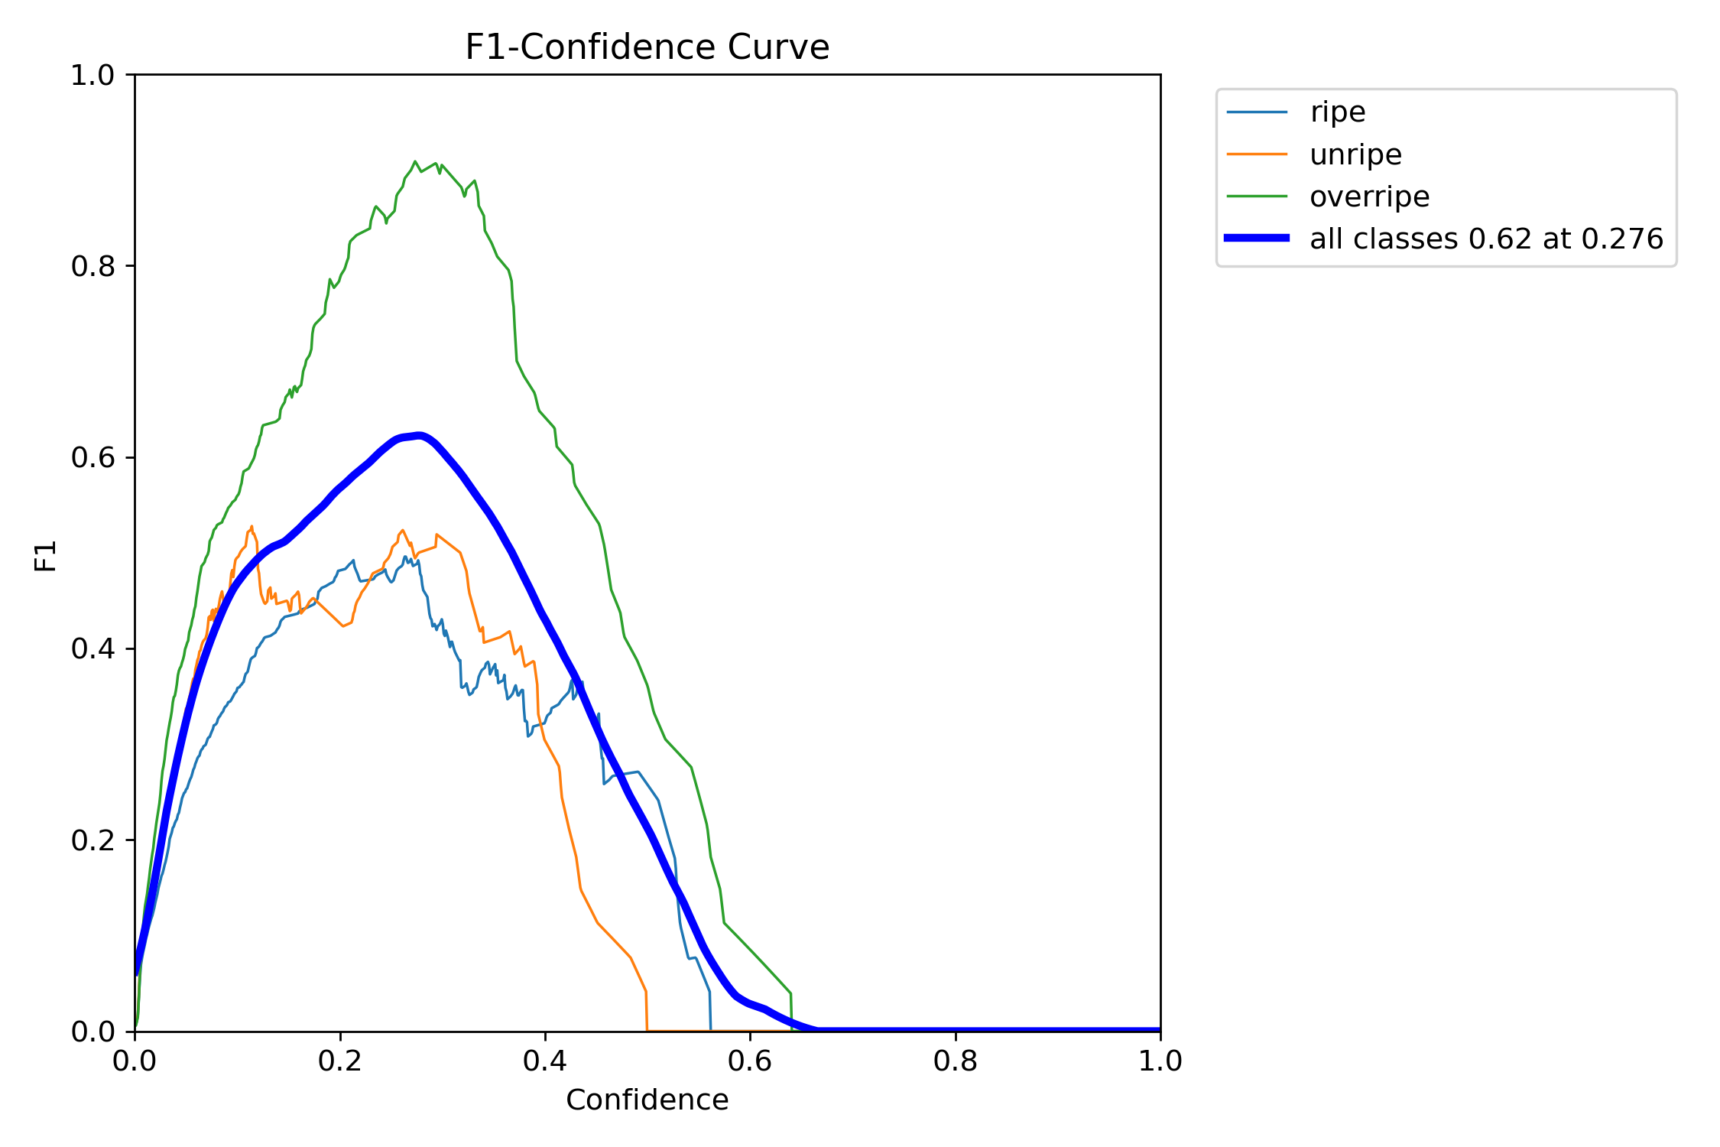
YOLOv8 Model
Photo by Pixabay

Slide 27
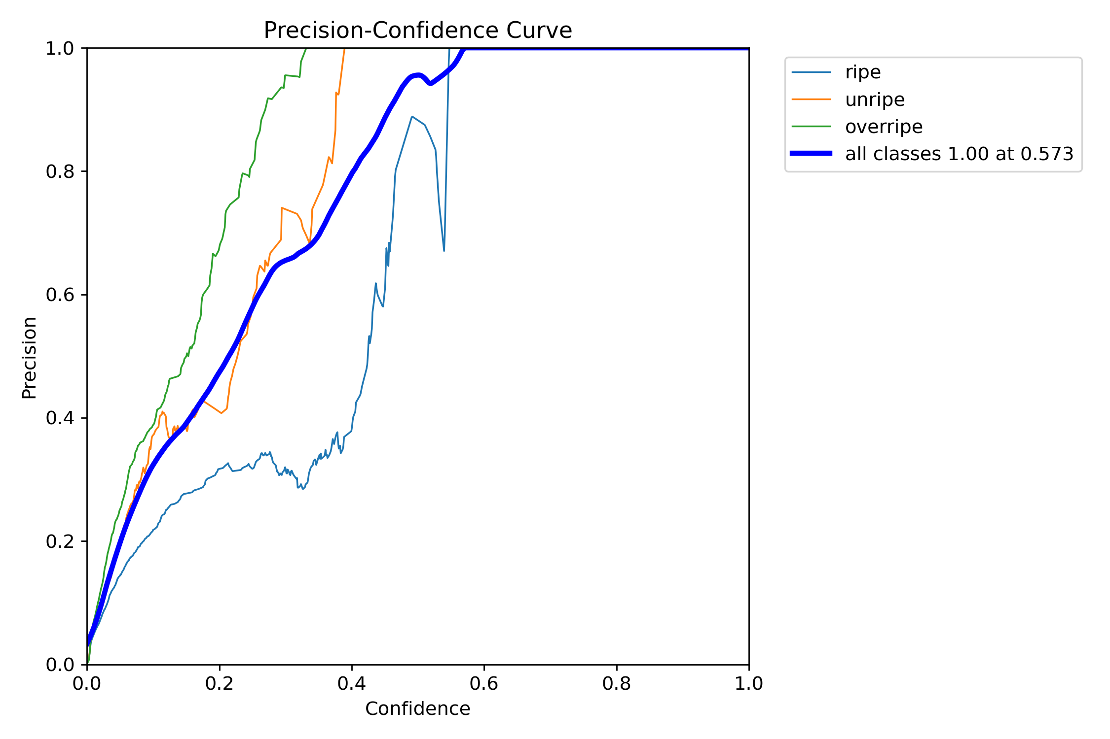
YOLOv8 Model
Photo by Pixabay

Slide 28
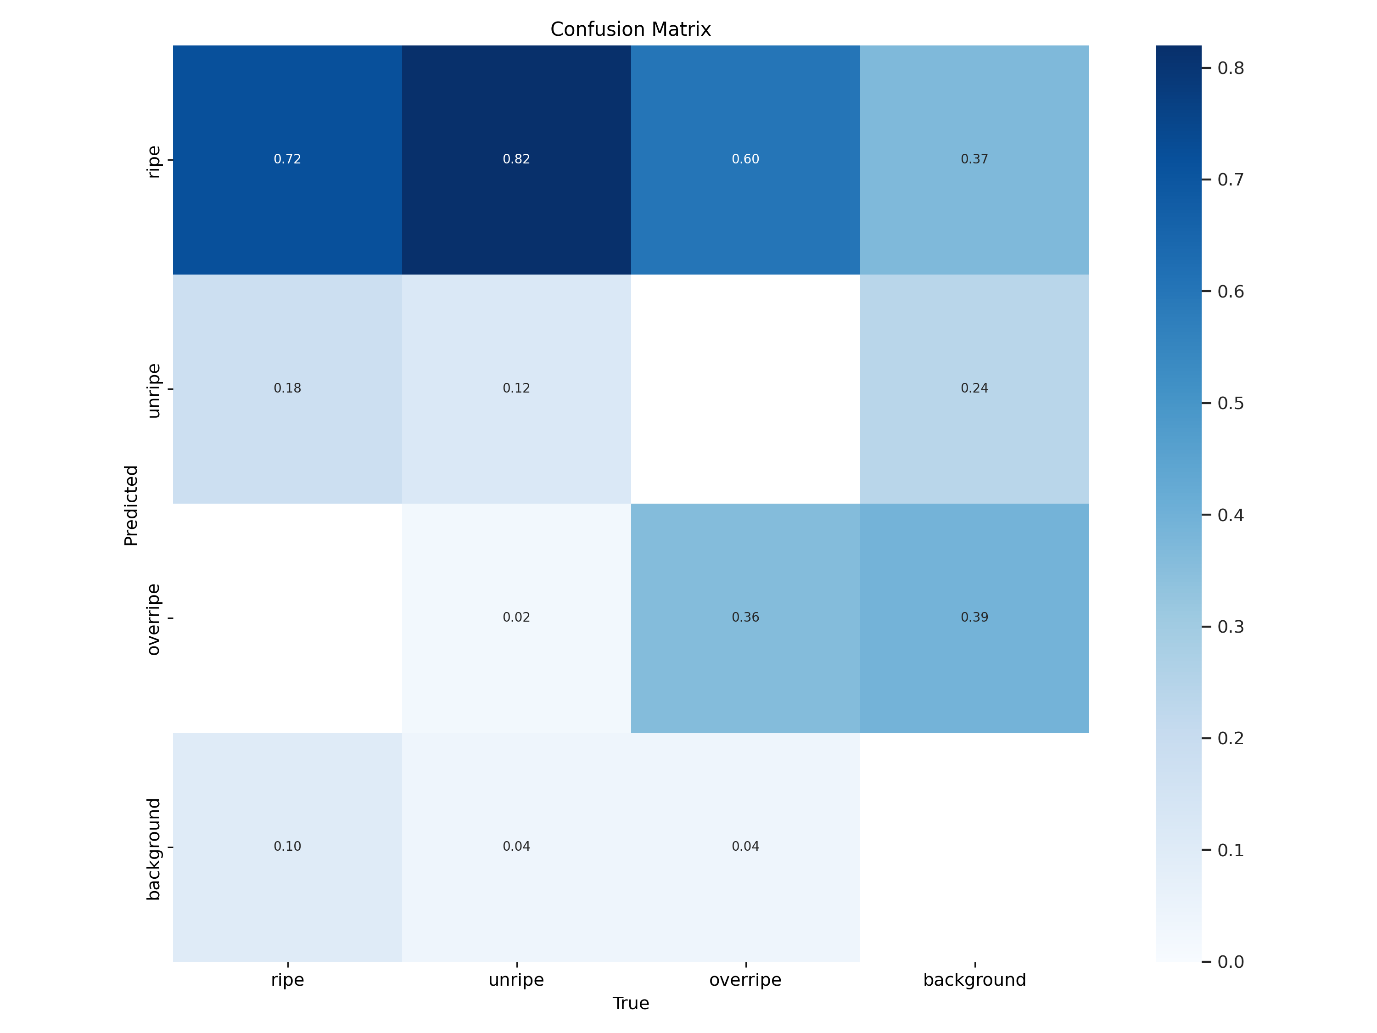
YOLOv8 Model
Photo by Pixabay

Slide 29
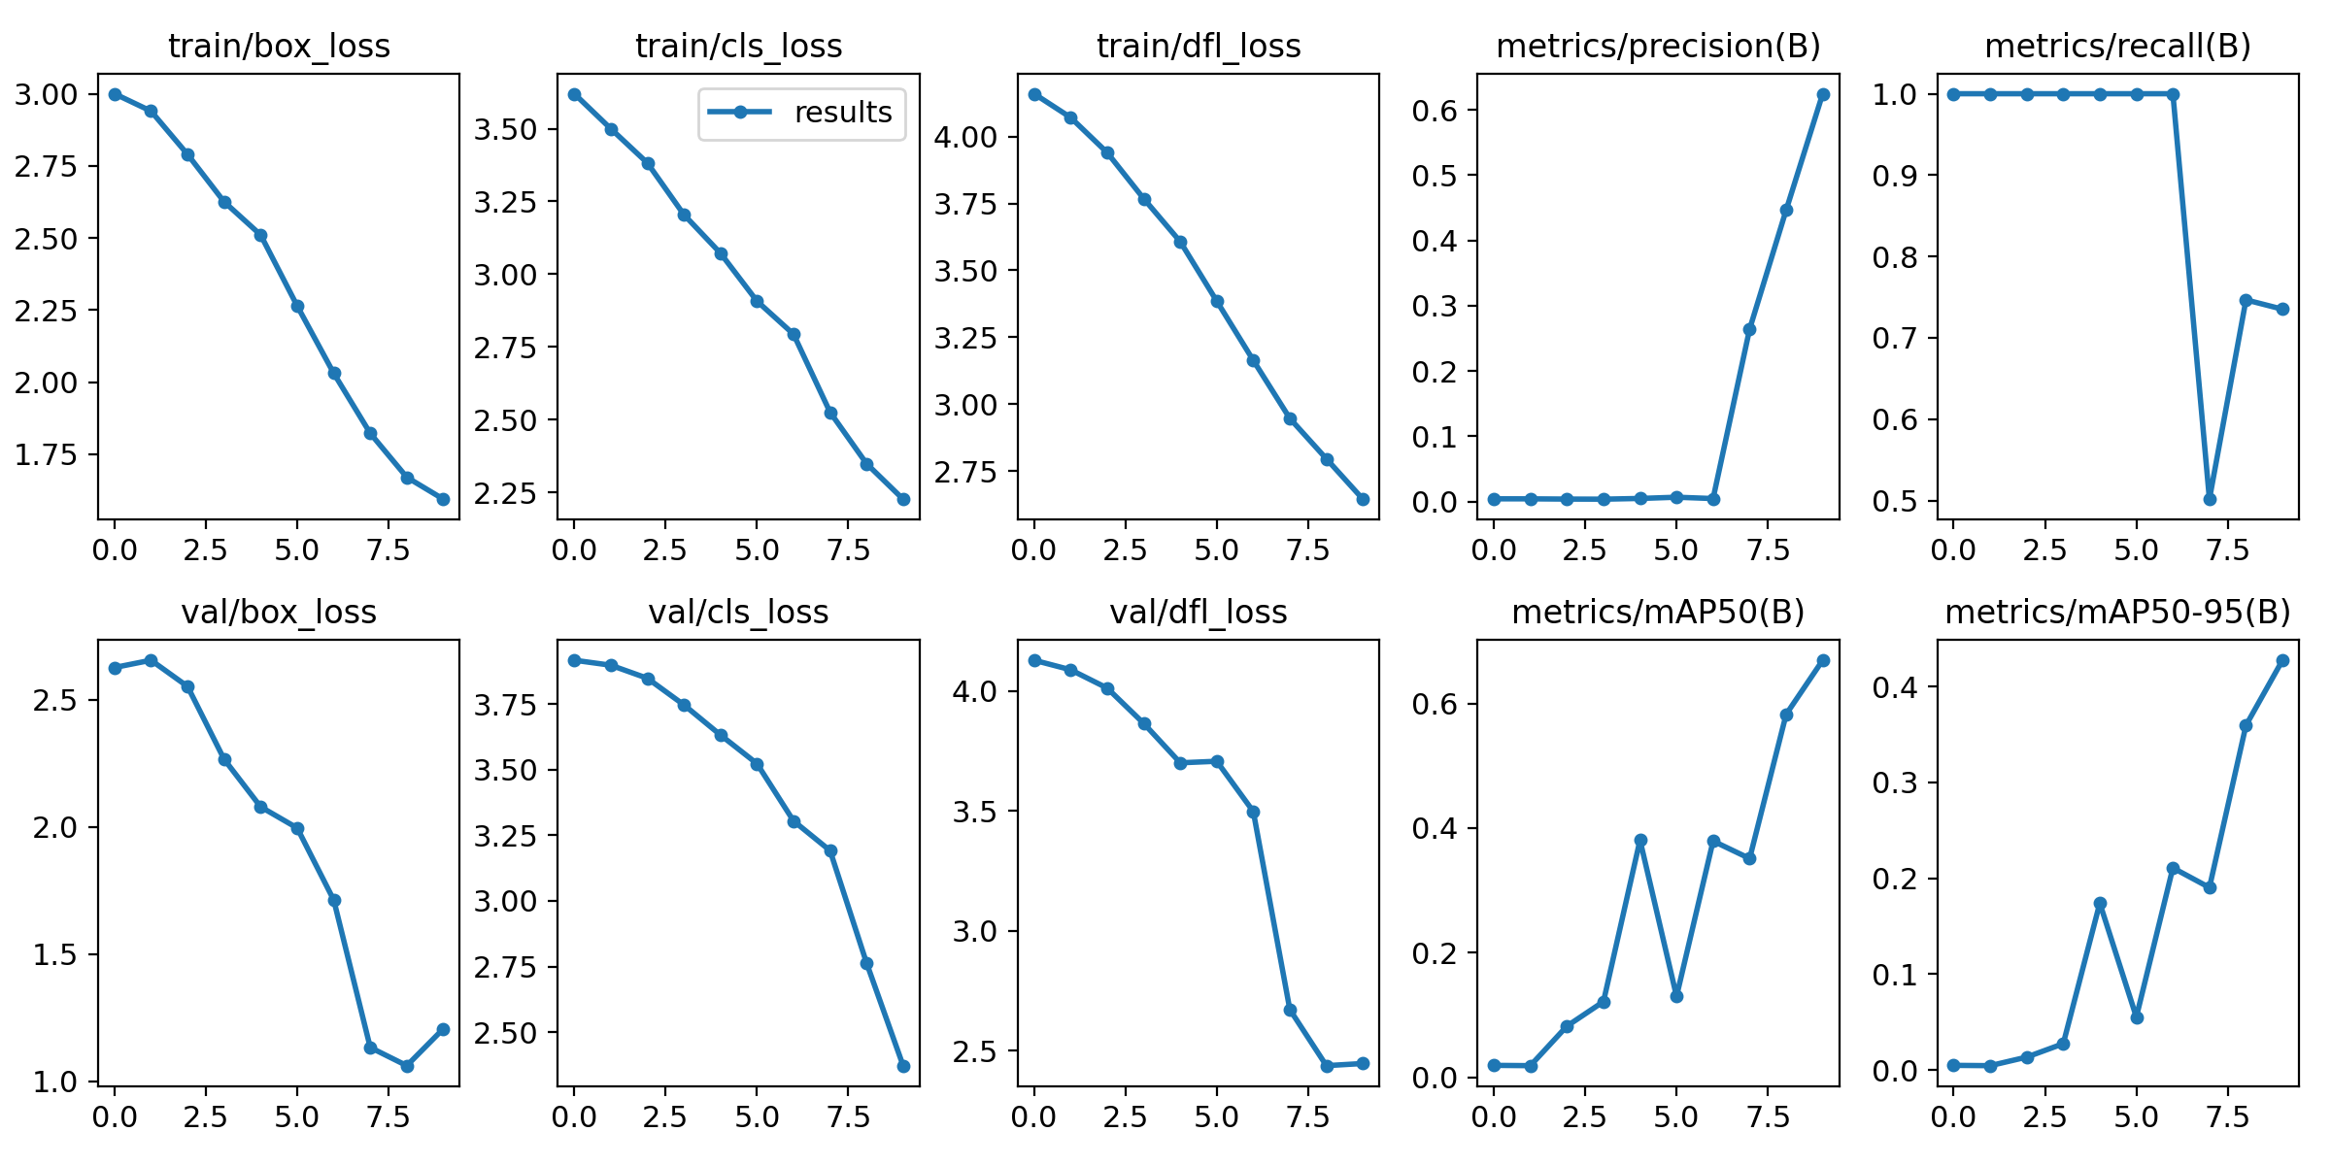
YOLOv8 Model Results
Photo by Pixabay

Slide 30

Software Requirements
- Python for programming and running the models.
- Google Colab for cloud-based machine learning.
- Convolutional Neural Networks (CNNs) for learning complex patterns in images.
- YOLOv8 Algorithm for object detection.
Photo by Pixabay

Slide 31
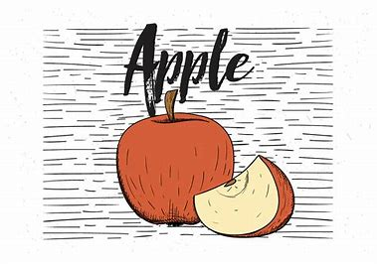
Conclusion
- Use of deep learning methods for apple maturity detection represents a significant advancement in the agriculture industry.
- Offers a more accurate, efficient, and cost-effective way to detect the ripeness level of apples.
- Can help improve the overall quality of apple production and distribution.
Photo by Pixabay

Slide 32
References
[1] Raja Hamza and Mohamed Chtourou, “Apple Ripeness Estimation using Artificial Neural Network,” in International Conference on High Performance Computing & Simulation, 2005
[2] Raymond Erz Saragih and Andi W.R. Emanuel, “Banana Ripeness Classification Based on Deep Learning using Convolutional Neural Network,” in 3rd east Indonesia Conference on Computer and IT, 2021
[3] Kaveri Kangune, Dr. Vrushali Kulkarni, and Prof. Pranali Kosamkar, “Grapes Ripeness Estimation using Convolutional Neural Network and Support Vector Machine,” in Global Conference for Advancement in Technology (GCAT) Bangalore, India, 2019
[4] Brahim Benmouna1 · Ginés Garcia‑Mateos1 · Sajad Sabzi2 · Ruben Fernandez‑Beltran1 ·
Dolores Parras‑Burgos3 · José Miguel Molina‑Martinez4 “Convolutional Neural Networks for Estimating the Ripening State of Fuji Apples Using Visible and Near‑Infrared Spectroscopy” in Food and Bioprocess Technology (2022) 15:2226–2236”.
[5] Yanfei Li, Xianying Feng, Yandong Liu & Xingchang Han “Apple quality identification and classification by image processing based on convolutional neural networks” in Scientific Reports | (2021) 11:16618.
[6] Real-time multi-object tracking and segmentation using Yolov8 with DeepOCSORT and OSNet, https://github.com/mikel-brostrom/yolov8_tracking (Feb 10,2023)
[7] J.Jayanth, Mansa Mahadevaswamy & M.Shivakumar “Fruit Quality Identification and Classification by Convolutional Neural Network”. SN COMPUT. SCI. 4, 220 (2023). https://doi.org/10.1007/s42979-022-01527-w
Photo by Pixabay

Slide 33
References
[8] Train Yolov8 object detection on a custom dataset | Step by step guide | Computer vision engineer “(6) Train Yolov8 object detection on a custom dataset | Step by step guide | Computer vision tutorial - YouTube”
[9] YOLOv8 | Object Detection on a Custom Dataset using YOLOv8 | Code With Aarohi “(6) YOLOv8 | Object Detection on a Custom Dataset using YOLOv8 - YouTube ”
Photo by Pixabay

Slide 34
Thank you for your time and attention 🙂

